Slide 1
ARITHMETIC PROGRESSIONS

Slide 2
Definition: Sequence with common difference
Example: 2, 5, 8, … is an A.P with common difference 3
General form: a, a+d, a+2d, …, a+(n – 1) d
nth term : a+(n -1 ) d

Slide 3
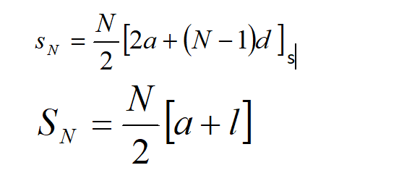
SUM OF N TERMS OF AN A.P:
3 /3

